Slide 1
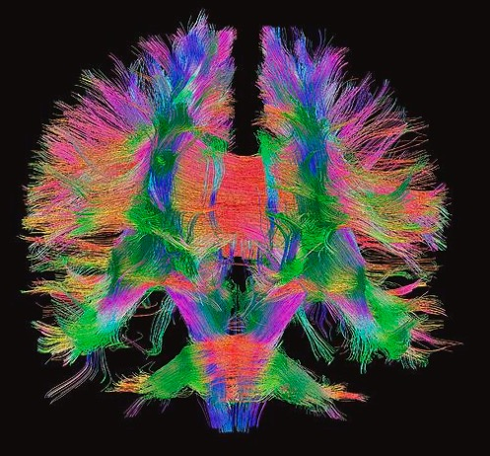

Structural Connectomes
MP / NTP 651
Figure: D. Tromp
Notes:
A major application of tractography is the mapping of structural connections between brain areas and the overall characterization of brain connectivity through connectomes

Slide 2
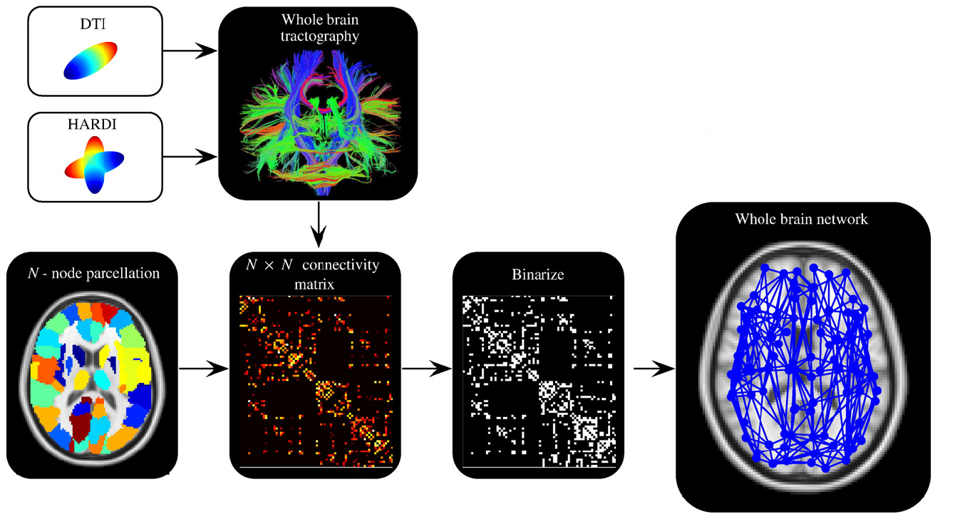
Framework of modeling human connectome using dMRI
[Zalesky et. al., 2010]
Notes:
The structural connectome for an indvidual is typically generated using whole brain tractography. Cortical and subcortical brain regions are defined and the tract connection properties between those regions are measured. A connectivity or association matrix of all regions is generated which maps the strength of connections between each pair of regions. This connectivity matrix can be thresholded to generate a binarized version, which is used to characterize brain network properties. We can then map these connections back onto the brain for visualization.

Slide 3
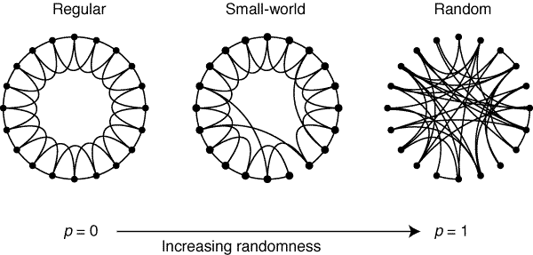
Structural Connectivity Networks
Networks: Nodes and Edges
Nodes: Brain regions
  (e.g., Cortex, Subcortical Nuclei)
Edges: White Matter Connections
  Tract Counts, Prob Tractography, Mean FA
Graph Theory
Theforwardlean.com
DT-MRI Alexander
Notes:
Connectomes attempt to describe the properties and topology of brain connectivity and define brain networks. The language of defining these connectomes is often based upon graph theory, which is a field of mathematics that is used to describe the properties of connections between objects and to define network properties. In graph theory, we define the nodes as the subgroups or objects being related and the edges are the connections between the nodes. In structural connectomes, the nodes are brain regions, for example, regions of cerebral cortex and deep brain regions and the edges are the tractography based connections between those brain regions. There are various ways that we can define the edges or connection properties including the tract counts, the probability of tract connections, or the average FA along a tract. We can define Global properties of brain connectivity using graph theory. Here we are looking at the randomness of connections between nodes. On the left, the regular graph is dominated by short range connections between all of the nodes. The case on the right is completely random with no underlying pattern or organization. It turns out that the human brain is actually more configured in a small world connectivity pattern which includes a lot of short range connections with several long range connections and this network configuration is highly efficient. It should be noted that this framework may be used to define the connectivity patterns of functional connectivity from resting state or task-based fMRI or for relating structural measurements like cortical thickness measurements between brain areas.

Slide 4
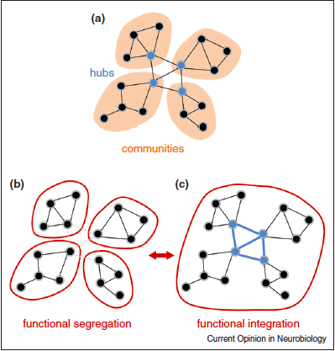
Graph Theory Network Measures
Sporns 2013
Notes:
We can also investigate more local brain connectivity properties by defining clusters of interconnected brain regions, which are communities. The brain regions that connect between the communities are referred to as the hubs. We can then investigate the properties of the connections both at the local or global level to understand how they relate to other factors of interest like age, disease, behavior, genetics and so on.

Slide 5
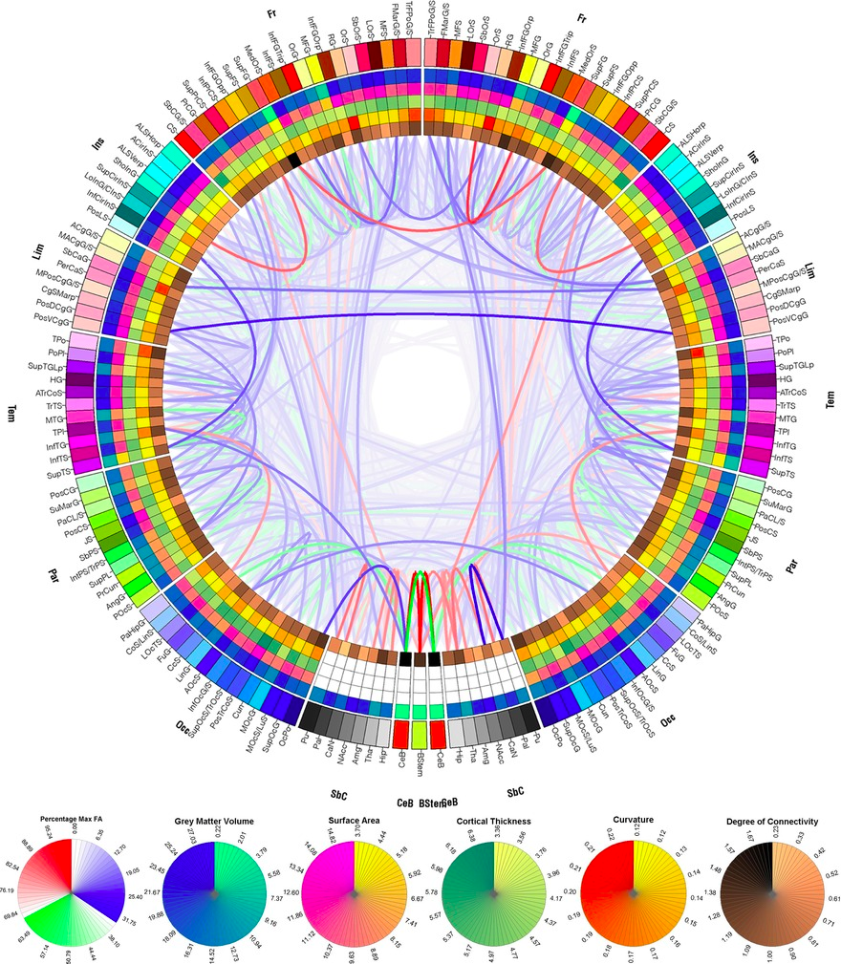
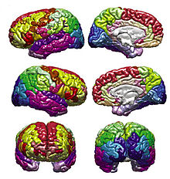
Connectogram
DT-MRI Alexander
Wikipedia
Notes:
One really interesting way to visualize the connections is using a connectogram, which arranges the brain regions or graph edges around a circle. The strength of connections is then represented using weighted curves connecting the groins.

Slide 6
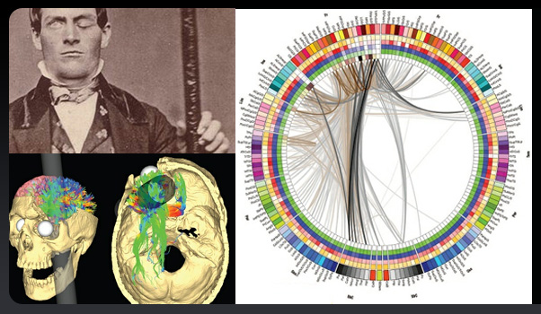
Phineas Gage Connectome
Van Horn 2013
DT-MRI Alexander
Notes:
An example of using a connectogram to depict how brain connectivity is shown here for a model of the interrupted brain connections in Phineas Gage’s brain after a profound brain injury with a steel post. Clearly many of the brain connections are modeled to be highy affected. Note that this is not based upon actual MRI data.

Slide 7
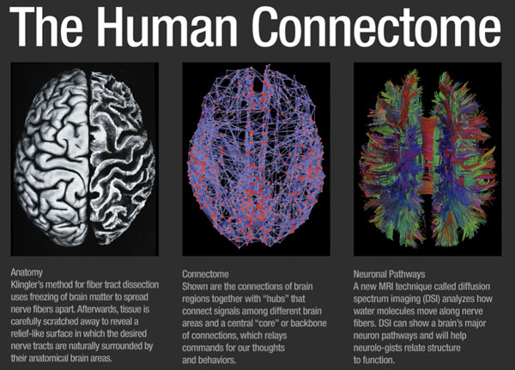
datanami.com
Notes:
Research on brain connectivity and connectomes has recently exploded with the Human Connectome project which collected high quality, high resolution structural MRI, functional MRI and diffusion weighted images. These data were collected on thousands of individuals across the lifespan and in a few disease groups including epilepsy and Alzheimer’s disease. These datasets are all available for download to the research community.

